Slide 1
Ball Collision Project Midpoint
By: Jeremiah Hsieh

Slide 2
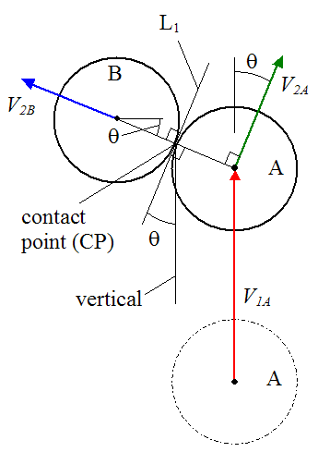
Overview
Perfectly elastic ball collision physics (2d/3d)
Current status:
2d perfect elastic balls mostly done
block/ball spawning
Block collision

Slide 3
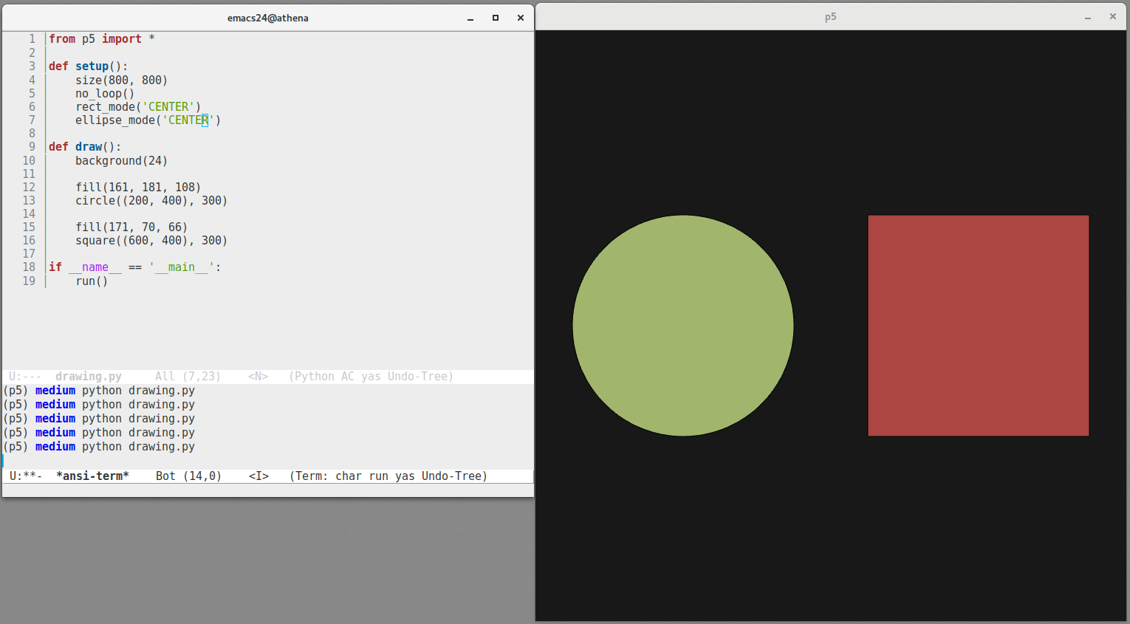
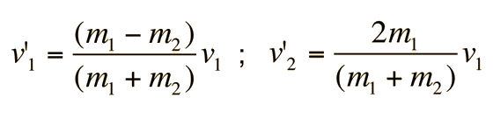
References
Newtonian physics
2d: manual render/equations and/or libraries (mostly pygame)
3d: unity/blender (not done)
https://en.wikipedia.org/wiki/Elastic_collision

Slide 4
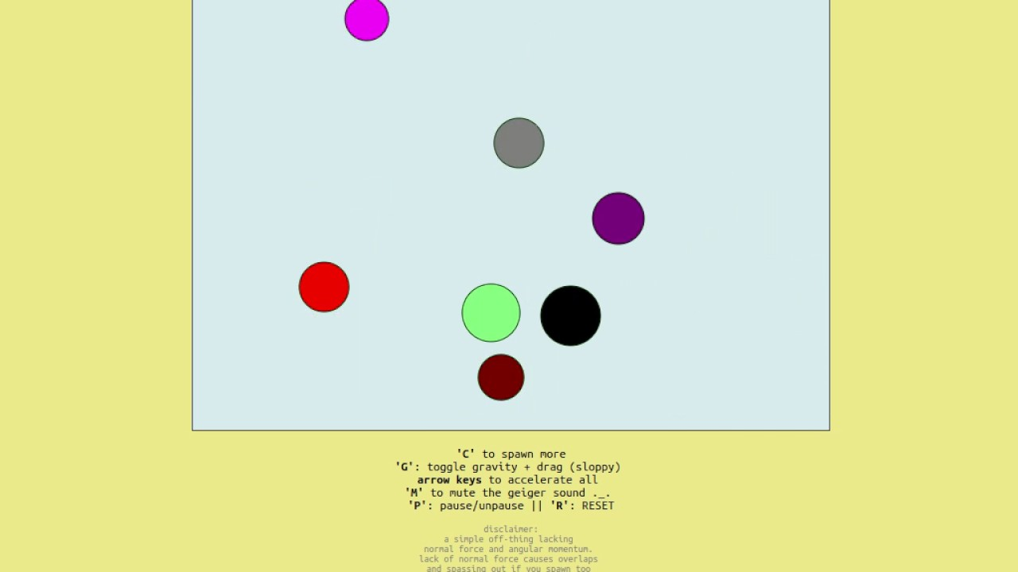
Main Idea
3 main parts
UI for inputting values (# balls, speed, etc.)
ball behavior physics calculator (using above values)
Graphics renderer (using above values)
Parts 2 and 3 mostly done
Part 1 currently only key presses

Slide 5
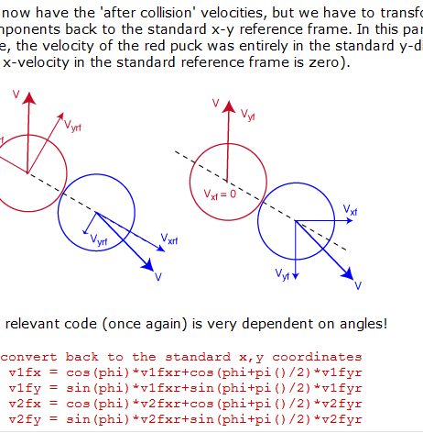
Plan and Milestone
Order of ease in implementation
UI
Physics calculator
Rendering images
2d seems simpler, 3d if needed
2 parts by midpoint

Slide 6
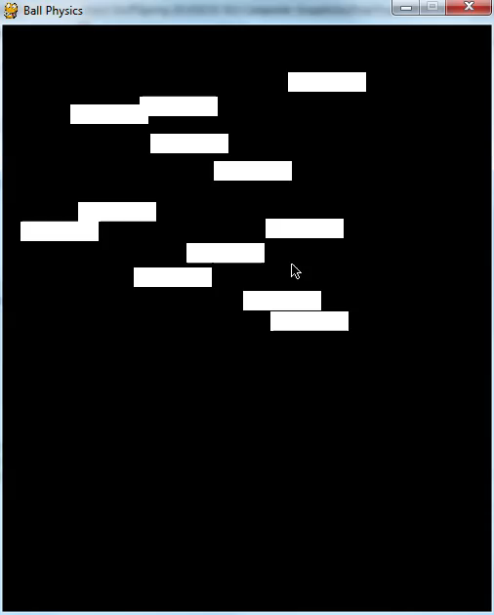
Summary
Learn how to:
render objects
edge collision detection
physics emulation
Moving forward
Fix collision errors
Add box collision
Add more menu/mouse interaction
See how difficult 3d conversion is

